Slide 1
Exam Revision
Miss L
Year 9

Slide 2
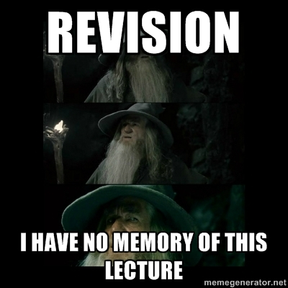




Slide 3
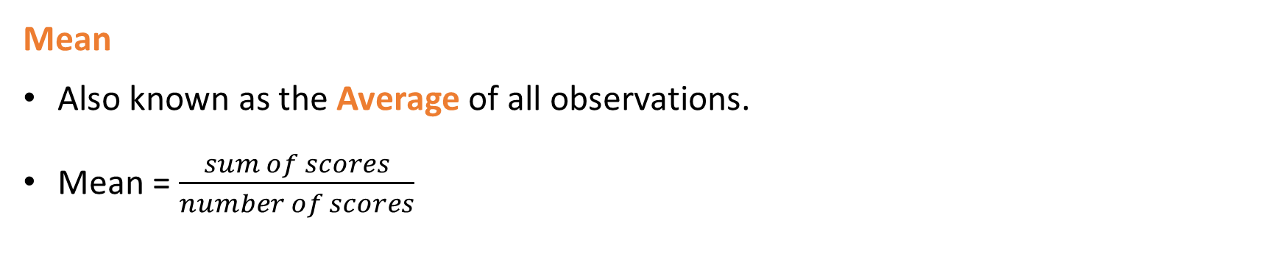
Data
Mean
Also known as the Average of all observations.
Mean = $\frac{sum of scores}{number of scores}$
Median – This is the middle value if the values are in order. If there are two middle values then add them together and divide by 2.
Mode = The value that occurs the most
Range = The maximum value – the minimum value
Outlier = Outliers are unusual values and we need to know how the affect our measures of location and spread.

Slide 4
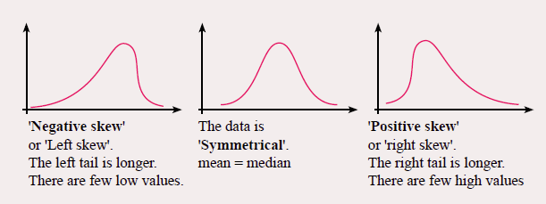

Slide 5
Stem and Leaf Diagrams
Here are the marks gained by 30 students in an examination:
63 58 61 52 59 65 69 75 70 54 57 63 76 81 64
68 59 40 65 74 80 44 47 53 70 81 68 49 57 61
0 4 7 9
2 3 4 7 7 8 9 9
1 1 3 3 4 5 5 8 8 9
Add a KEY:
0 0 4 5 6
0 1 1
5|2 = 52
4
5
6
7
8

Slide 6
Back to Back Stem and Leaf Diagrams
Here are the ages of patients on admission to a hospital
Males: 2 13 24 39 45 45 48 56 58 59 59 62 64 64 68 69
Females: 1 12 14 23 28 37 39 39 42 42 45 46 51 57 58 63 65 71 88
2
3
4
9
8 5 5
9 9 8 6
9 8 6 4 4 2
1
2 4
3 8
7 9 9
2 2 5 6
1 7 8
3 5
1
8
4|2 = 52
0
1
2
3
4
5
6
7
8

Slide 7
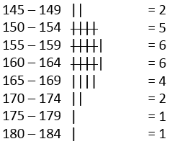
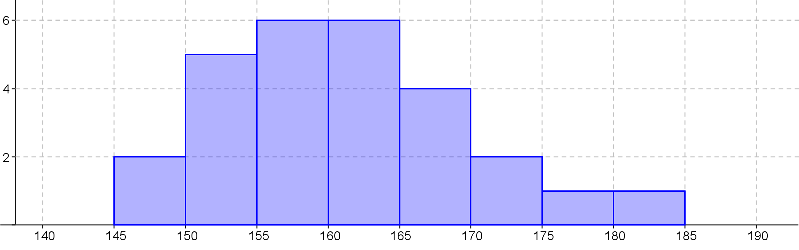
Histograms
Heights of students in 8-7
Title
Frequency
No Gaps between the columns
Labels
Height(cm)

Slide 8
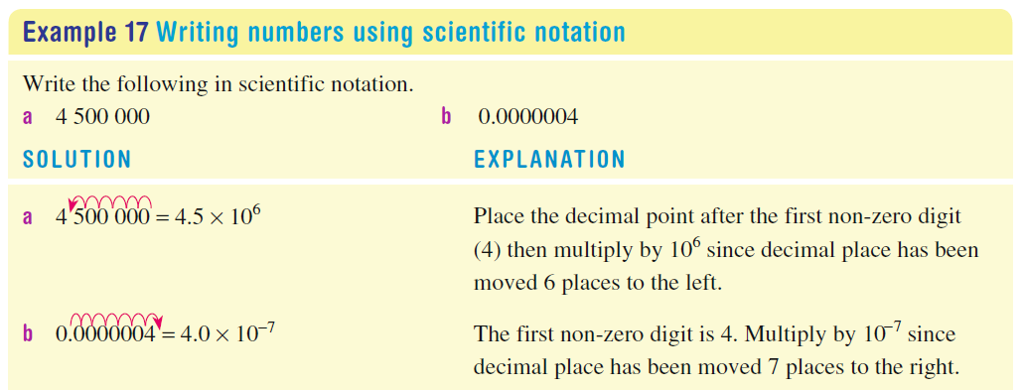
Scientific Notation

Slide 9
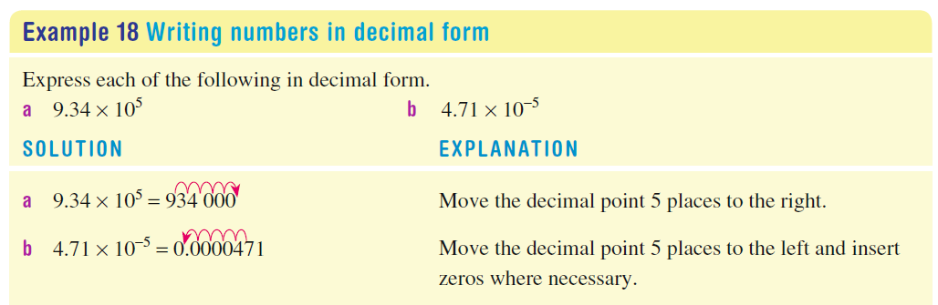

Slide 10
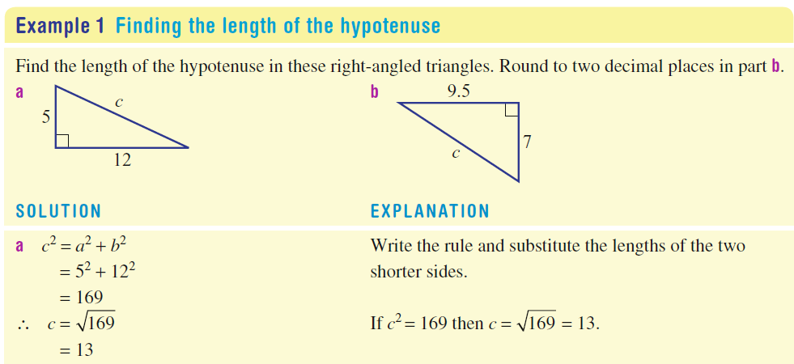
Pythagoras Theorem

Slide 11
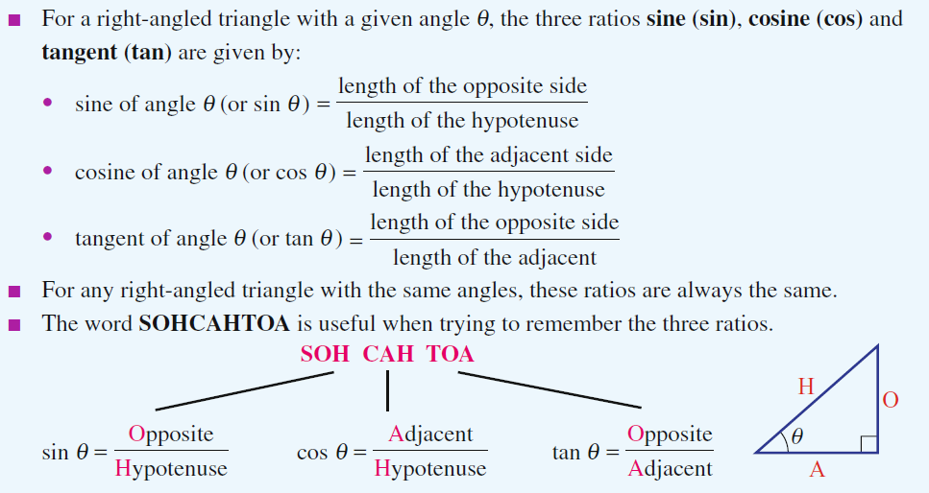

Slide 12
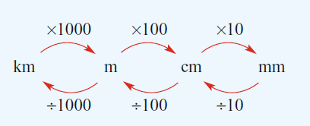
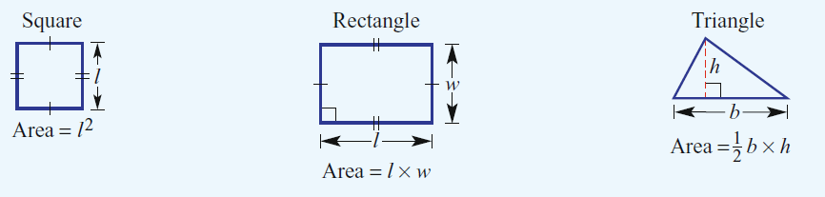
Measurement

Slide 13
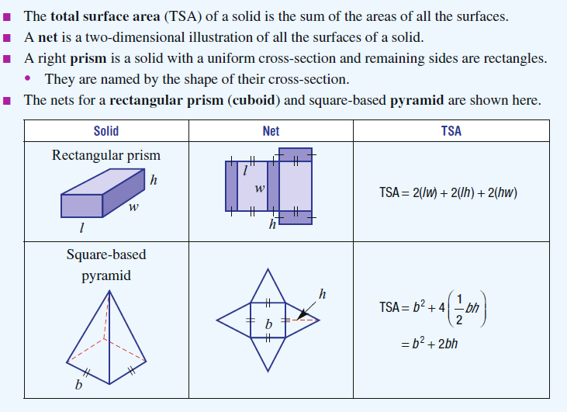

Slide 14
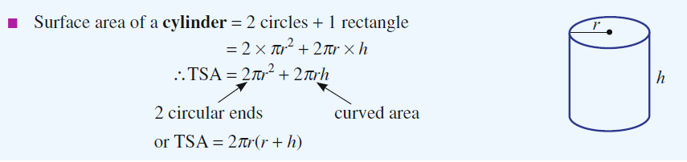

Slide 15
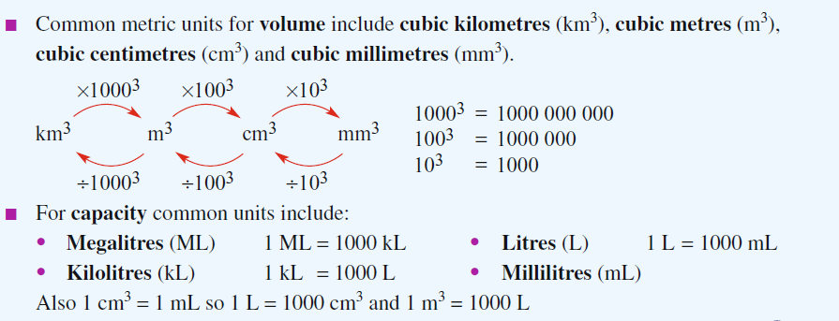

Slide 16
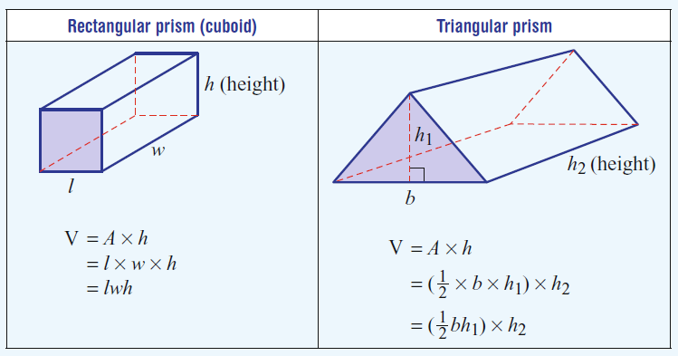

Slide 17
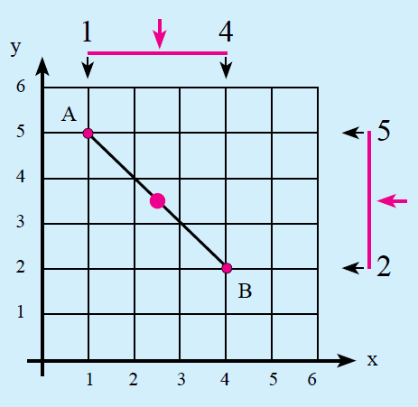
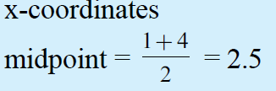
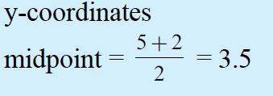

24
7
30
Topic: Midpoint of a Line
Date:
EQ – How do you find the midpoint?
Find the midpoint between A(1,5) and B(4,2)
Step 1: Find the midpoint for the x – coordinates
Step 2: Find the midpoint for the y – coordinates
Step 3: Put the answers in coordinate form

Slide 18
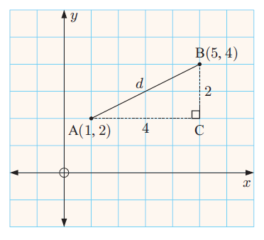

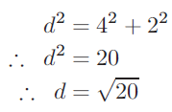
Topic : Length of a Line
24
7
30
Date
EQ : How do you find the length of line?
How do we find the distance between 2 points?
Using Pythagoras.
d² = a² + b²
d = 4.47

Slide 19
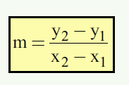
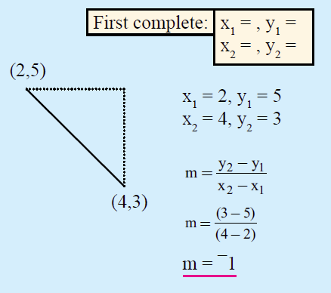
24
7
30
Topic: Gradient of a Line between two coordinates
EQ – What are the difference to just doing rise / run ?
Using a formula: Gradient of the Line

Slide 20
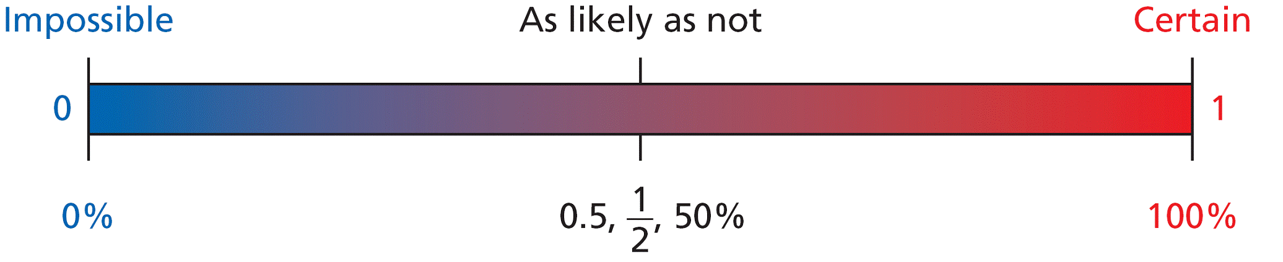
Probability
Probabilities are written as fractions or decimals from 0 to 1, or as percents from 0% to 100%.
A Sample Space is a list of all the possible outcomes.
Eg flipping a coin = {heads, tails}
rolling a dice = {1,2,3,4,5,6}

Slide 21
Probability - Experimental vs. Theoretical
Experimental probability:
P(event) = number of times event occurs
total number of trials
Theoretical probability:
P(E) = number of favorable outcomes_
total number of possible outcomes

Slide 22
Relative frequency = $\frac{Number of times an outcome occurs}{total number of outcomes}$
House roof | Numbers | Relative Frequency
Tiles | 192 | 192 ÷ 400 = 0.48
Shingles | 4 | 4 ÷ 400 = 0.01
Tin/Steel sheet | 204 | 204 ÷ 400 = 0.51
Total = 400
Expected frequency=probability × number of trials
If there were 1200 homes, how many would have tiled roofs?
1200 x 0.48 = 576

Slide 23
Probability
Tree diagram.
Eg. Three coins are thrown together. Use a tree diagram to show the sample space
Second Coin
Third coin
First coin
H
=HHH
H
=HHT
H
T
H
=HTH
T
T
=HTT
H
=THH
H
=THT
T
T
H
=TTH
T
T
=TTT
Q. What is the probability that I will get at least 2 heads?
=4/8
=1/2

Slide 24
A two way table is another way to display the outcomes of a 2 step experiment. We can then use the results to calculate probability.
Example
a dice is thrown and a coin is tossed. Determine the possible outcomes
 | 1 | 2 | 3 | 4 | 5 | 6
Heads | 1, Heads | 2, Heads | 3, Heads | 4, Heads | 5, Heads | 6, Heads
Tails | 1, Tails | 2, Tails | 3, Tails | 4, Tails | 5, Tails | 6, Tails

Slide 25
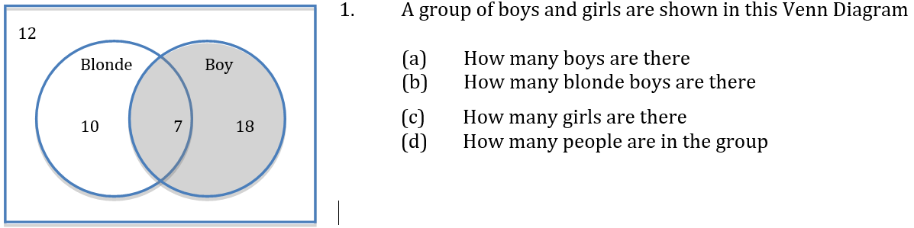
Venn diagrams
Total number of blonde boys is 7
Total number of boys is 7 + 18
The total number of people in the group is 12 + 10 + 7 + 18
Total number of girls is 10 + 12 (blondes who aren’t boys or people who aren’t boys or blonde)

Slide 26
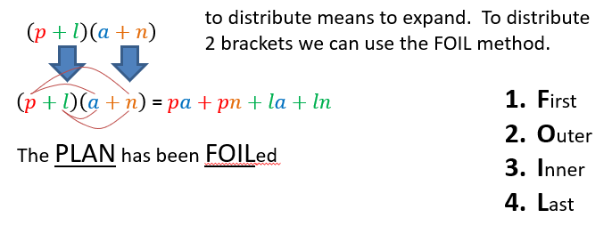
Expanding Brackets

Slide 27
